Slide 1

Group 2
AA Group Slides

Slide 2
Problem
Multi-class classification problem
Classify text documents into 5 different news categories
To perform classification, various supervised machine learning models will be leveraged

Slide 3
Classification Models
Dominic -–> Logistic Regression
Kai Chong --> Support Vector Machine
Ian --> Gradient Boosting
Kendric --> Naive Bayes
Eugene --> Random Forest

Slide 4
Steps Taken
Start off with an initial model
Train using all the datasets and find the dataset with the best accuracy
Fine tune the model using grid search and X as the dataset
Compare best model among all classifiers

Slide 5
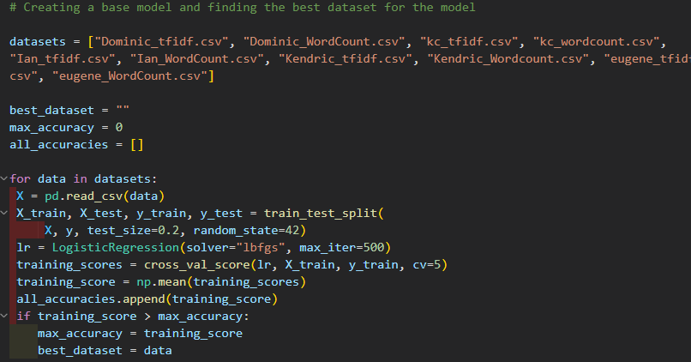
Code for finding the best dataset
Loops through all the datasets
80-20 train-test split
Metric used is the average of all training scores

Slide 6
Logistic Regression (Multinomial)
Pros
Simple algorithm, short training times
Ideal for low dimensional datasets
Very efficient when features are linearly separable
Cons
Not ideal for high dimensional datasets
Data must follow the logistic regression assumptions
Cannot capture complex relationships

Slide 7
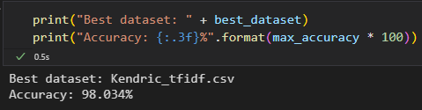
Best Dataset

Slide 8
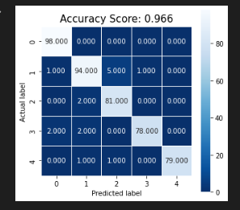
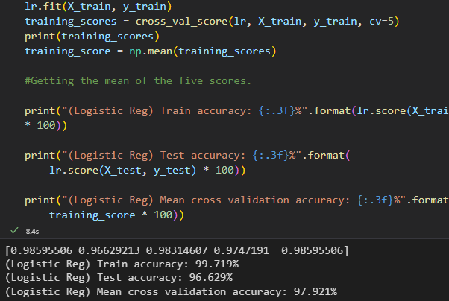
Initial Model Accuracy
Initial Model Heat Map

Slide 9
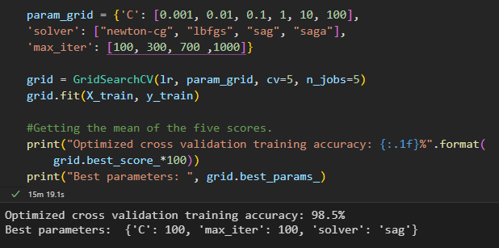
Fine tuning the Model
"C": Inverse of regularization strength
The smaller the value the more it will reduce overfitting
"solver": Algorithm used in the optimization problem
Used all solvers that can be used on multiclass problems
"max_iter": Maximum number of iterations before the solver must converge
Converge means the loss of the model starts to stabilize meaning model has "learned" finish

Slide 10
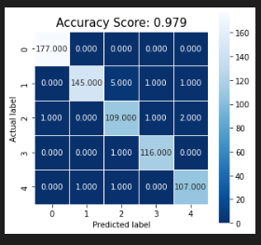
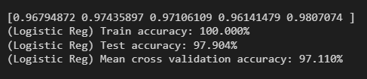
Fine Tuned Model Accuracy
Fine Tuned Model Heatmap

Slide 11
Random Forest Model

Slide 12
Random Forest Models
Pros
Robust to outliers
Lower risk of overfitting
Runs efficiently on a large dataset
Cons
Random forests are found to be biased while dealing with categorical variables
Slow Training

Slide 13
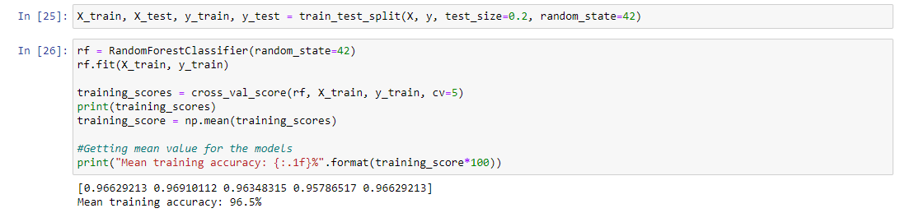
Model using own dataset
80-20 train-test split
Cross validates score and finds average accuracy

Slide 14
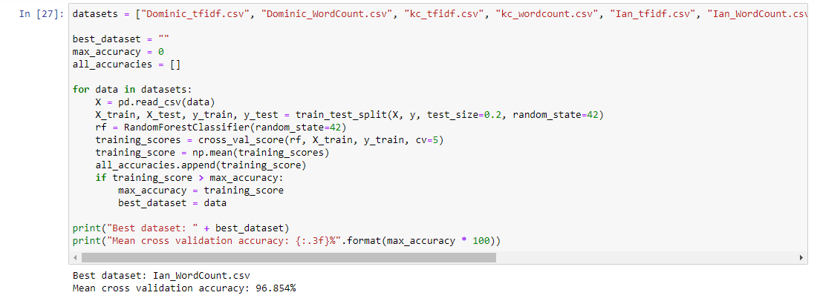
Code for finding the best dataset
Loops through all the datasets
80-20 train-test split
Metric used is the average of all training scores

Slide 15
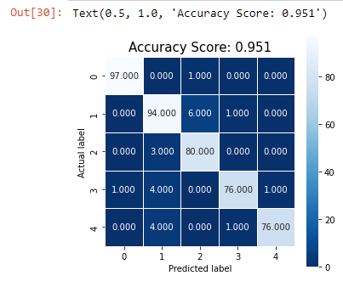
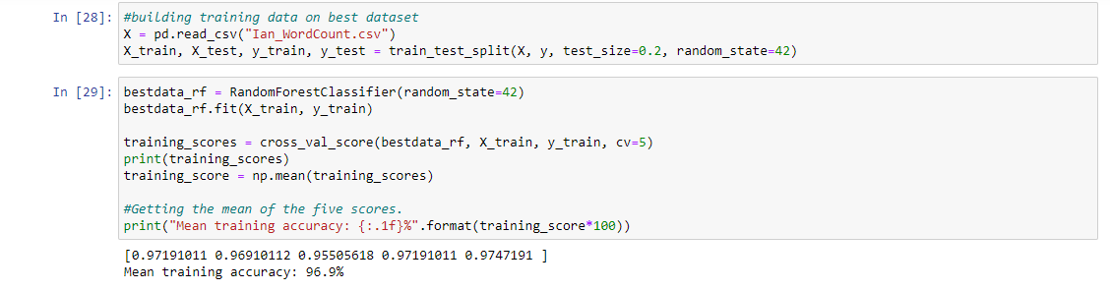
Training the model using best dataset

Slide 16
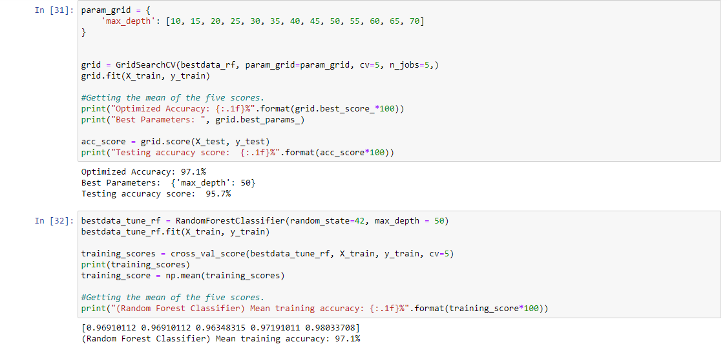
Fine tuning the Model
Finds the best max depth for random forest model using best data
Build model using the new optimized hyperparameters

Slide 17
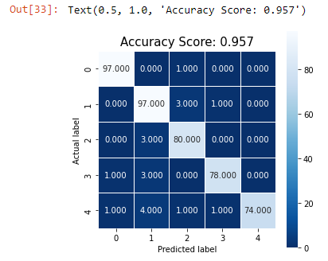
Heatmap of tuned model

Slide 18
Gradient Boosting

Slide 19
Gradient Boosting
Pros
Flexible, several hyperparameters can be optimized
Accepts various types of data
Generally, more accurate than other models
Cons
Computationally slow as it often requires many trees hence time and memory exhaustive
Final model hard to interpret
More likely to overfit

Slide 20
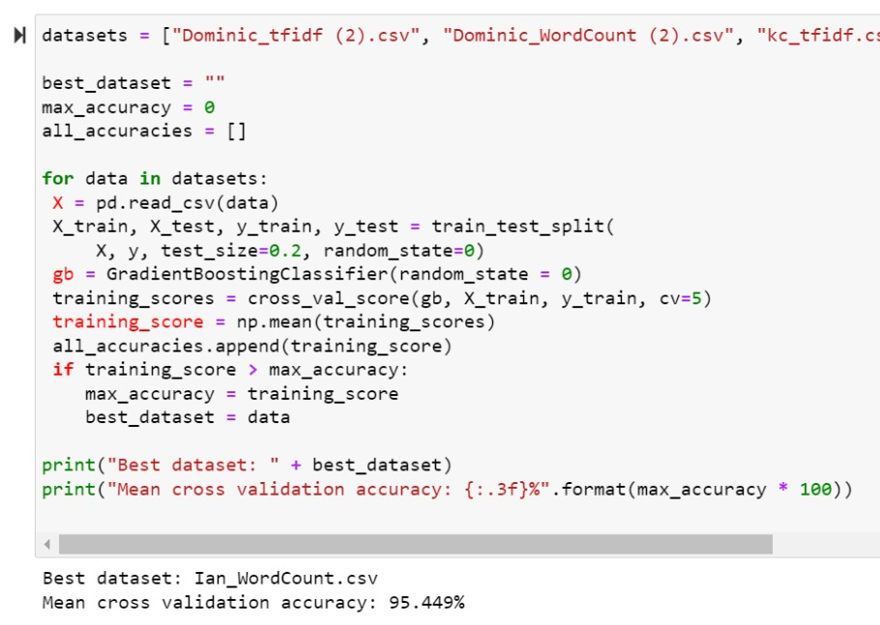
Best Dataset Selection
For loop runs gradient boosting on all datasets
Returns the data set with the highest mean cross validation accuracy
Best dataset: Ian_WordCount.csv
Mean cross validation accuracy: 95.449% (estimated) (exact values in next slide)

Slide 21
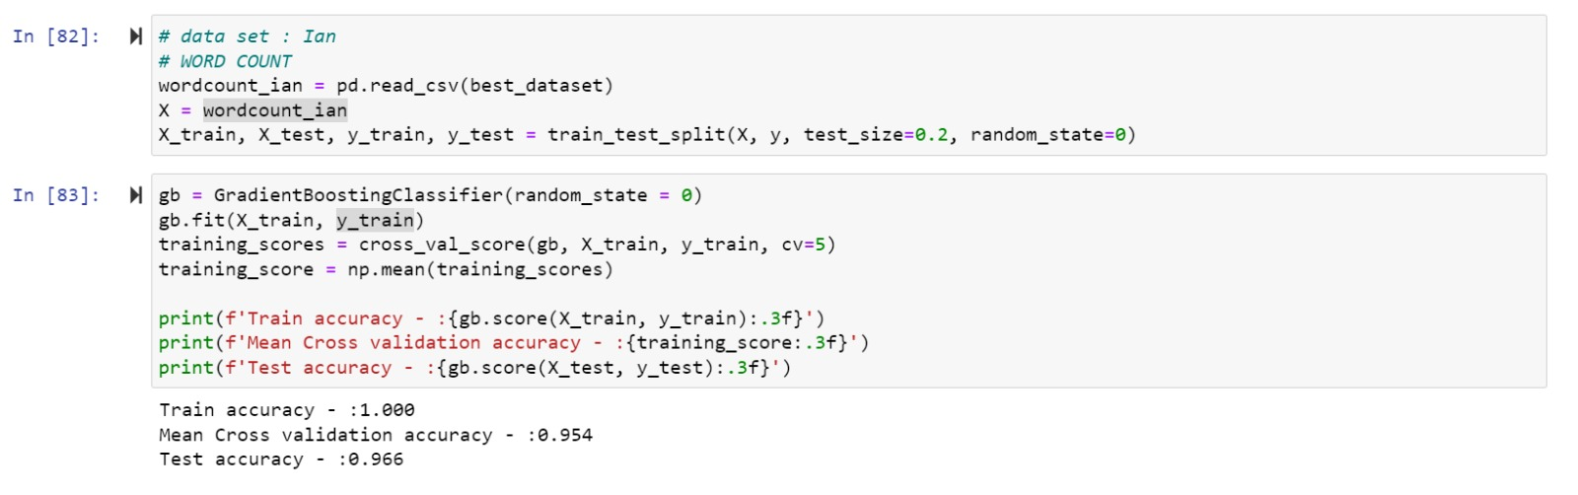
Exact values
Train accuracy : 1.000
Mean Cross validation accuracy : 0.954
Test accuracy : 0.966

Slide 22
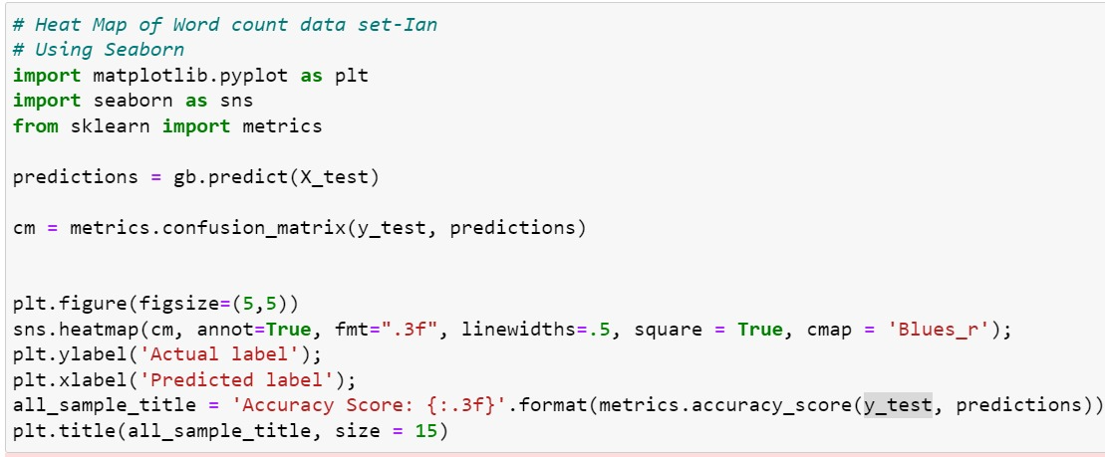
Best Dataset Selection
Code for heat map for better visualization of the chosen dataset (heatmap on next slide)

Slide 23
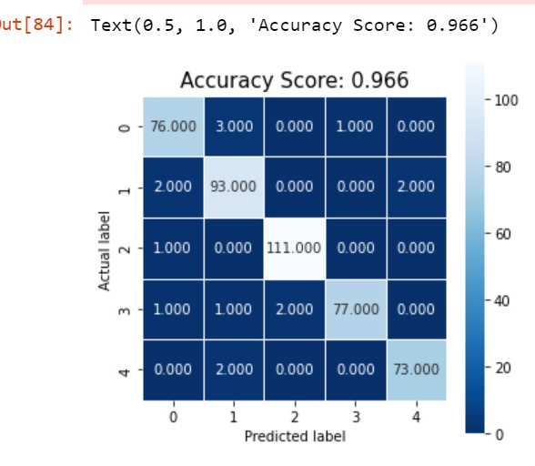
Heatmap

Slide 24
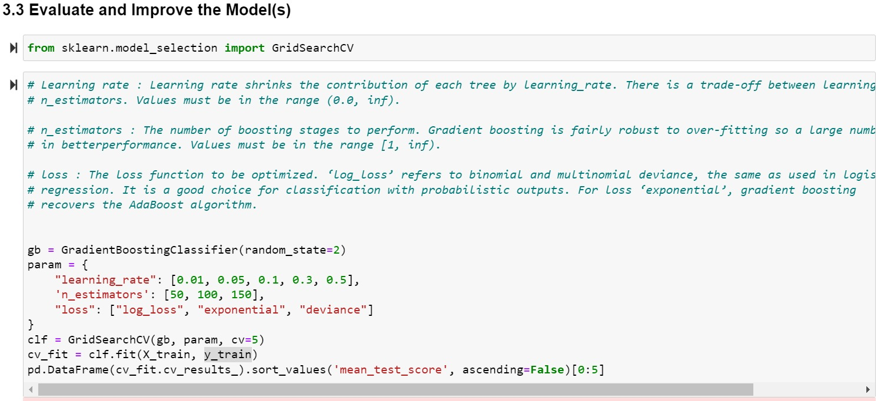
Grid Search
An optimization tools to find the most optimized parameters
Parameters chosen to test: Learning rate, n estimators and loss

Slide 25
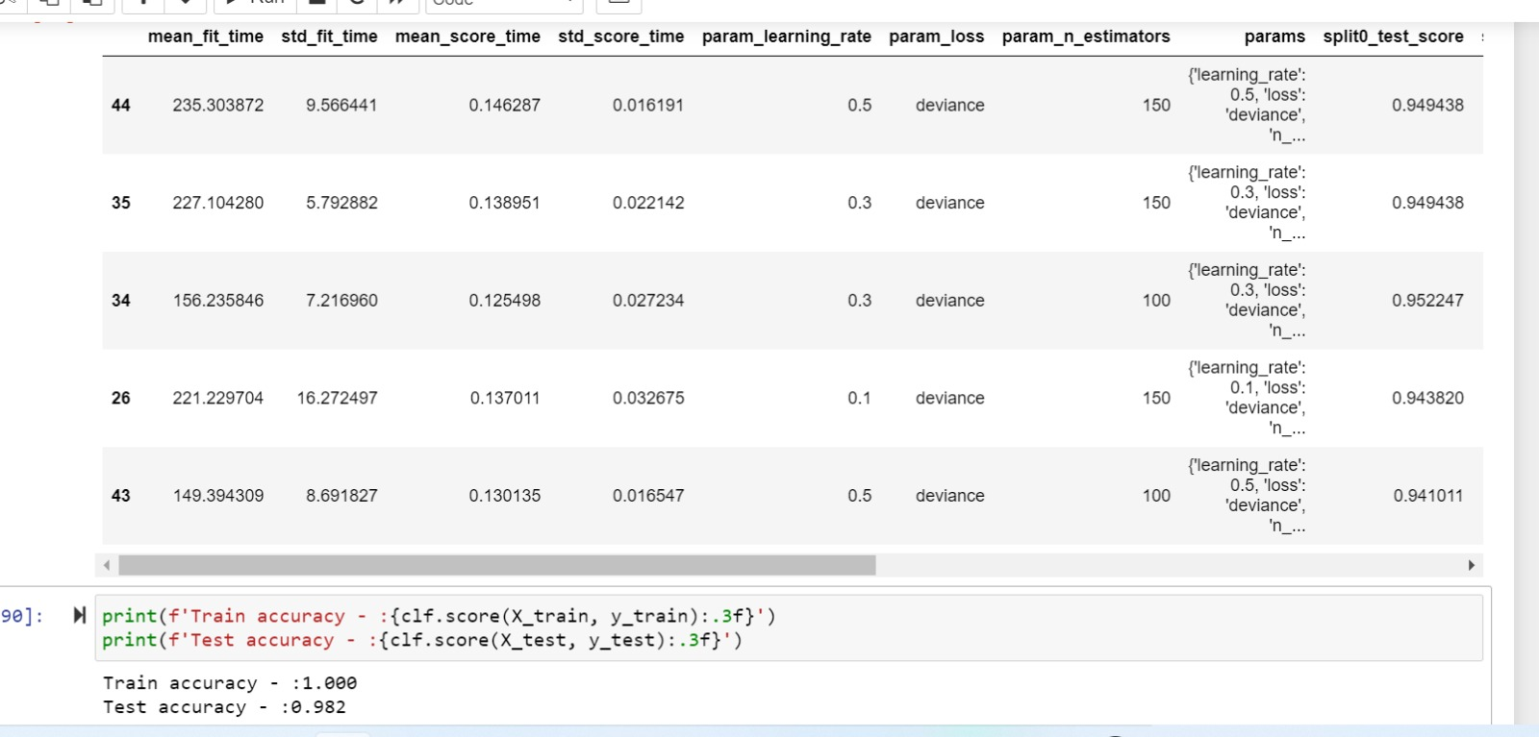
Grid Search Results
Rank test score (1)
Newly Found Parameters:
N estimators = 150
Loss = "deviance"
Learning rate = 0.5
Mean test score = 96.0112%

Slide 26
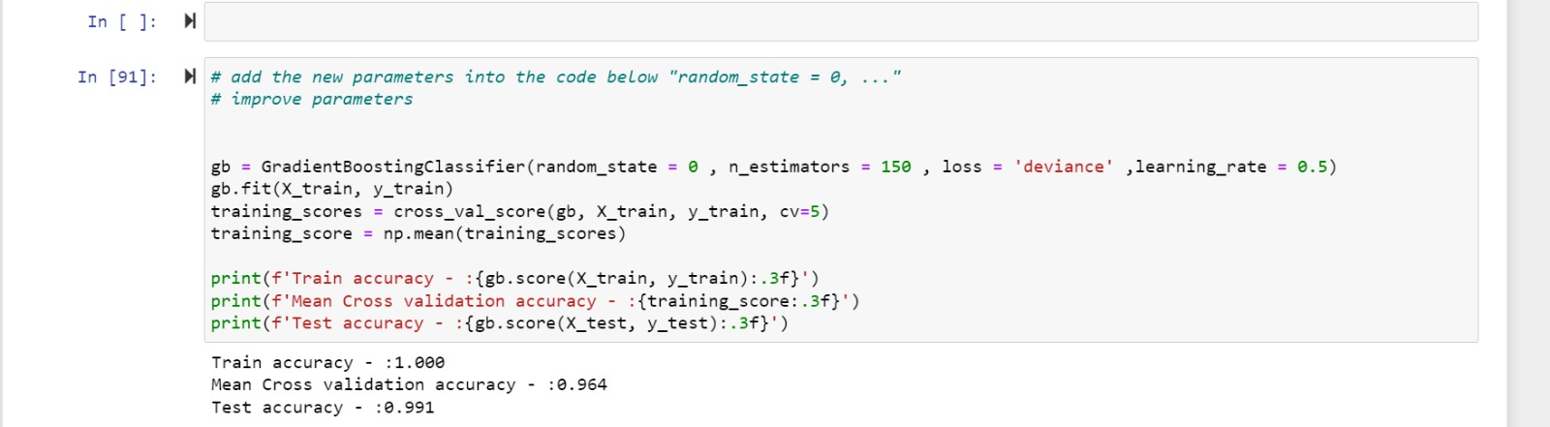
Gradient Boosting with Newly Found Parameters
Train accuracy : 1.000
Mean Cross validation accuracy : 0.964 (previously 0.954)
Test accuracy : 0.991 (previously 0.966)

Slide 27
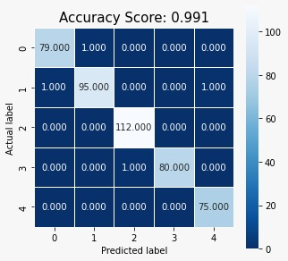
Heatmap With New Parameters

Slide 28
Naïve Bayes Model

Slide 29
Naïve Bayes( Gaussian)Models
Pros
Fast / easy predict class
Perform better with less training data
Can solve multi class prediction
Cons
Notorious as a lousy estimator
Hardly find independent features.
Notes:
Naïve Bayes is a fast and easy supervised learning algorithm used for machine learning. It performs better with less training data and can be used for multi-class classification. However, it has been known to be a poor estimator

Slide 30
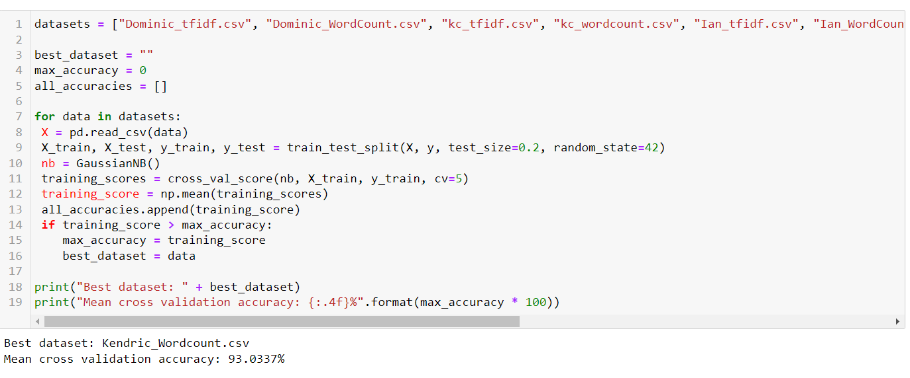
Code for finding the best dataset
Loops all the datasets
80 – 20 train-test split
Notes:
For Naïve Bayes, we first looped through all datasets

Slide 31
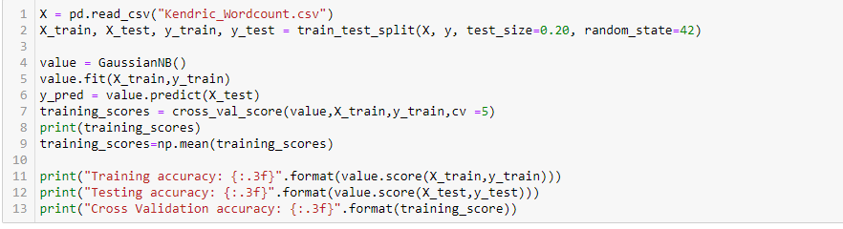

Training the model using best dataset
Notes:
Thereafter, we obtain the best dataset, which achieved a test accuracy of 90%

Slide 32
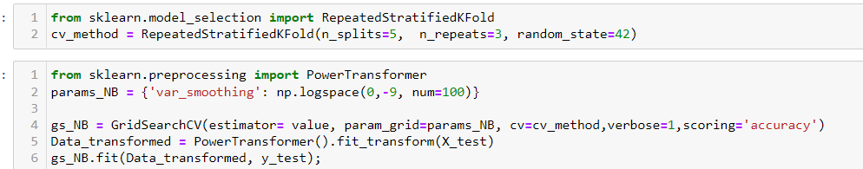
Improving the model
estimator is the machine learning model of interest
Verbose { the higher , the more message}
Var_smoothing is a stability calculation
Notes:
Thereafter, we used GridSearchCV to improve the model

Slide 33
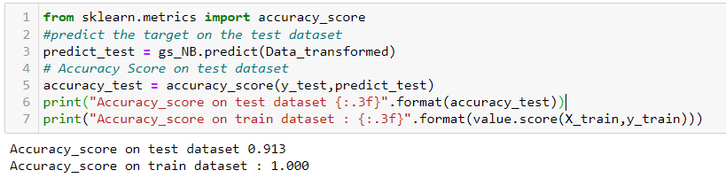
After tuning
Notes:
After tuning the hyperparameters, we can see that the test accuracy increased to 91.3%

Slide 34
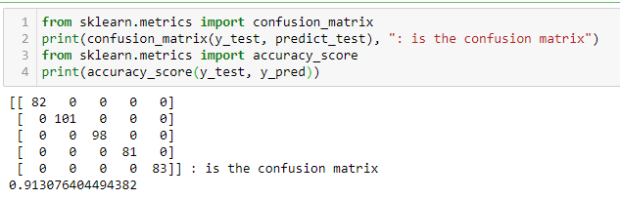
Confusion Matrix
Notes:
Here is the confusion matrix for the Naïve Bayes model

Slide 35
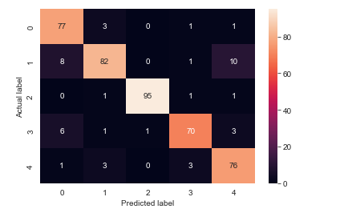
Heat Map
Notes:
And here is the heat map

Slide 36
Support Vector Machine
Notes:
Moving on, our team also built a support vector machine model

Slide 37
Support Vector Machines (SVM)
Pros
Can be used for classification, regression and outlier detection
Very good for classifying linearly separable data
Effective in high dimensional spaces
Cons
SVMs require full labelling of input data
Not suitable for large datasets
Notes:
In machine learning, SVMs are supervised learning algorithms. They can be used for classification, regression and outlier detection. The SVM algorithm is able to efficiently classify linearly separable data. In addition, SVMs are effective in high dimensional spaces. However, SVMs require full labelling of input data and is generally not suitable for large datasets.

Slide 38
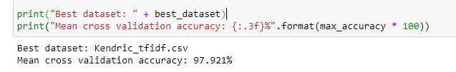
Best Dataset
Notes:
In Python, we use the LinearSVC() as our SVM implementation. After running through all datasets we identify that Kendric's tfidf was the best dataset for the SVM model.

Slide 39

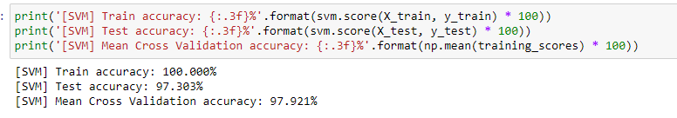
Initial Model Accuracies: Train Accuracy –100% Test Accuracy-97.3% Cross Validation Accuracy-97.9% -> Indications of overfitting!
Notes:
From the figure, we can see that the initial test accuracy of the model is 97.3%, with a C value of 10, and a L2 penalty or regularization.

Slide 40

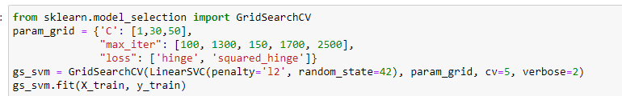
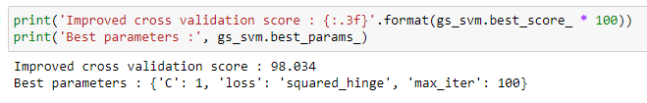

GridSearchCV attempt #1
GridSearchCV attempt #2
Best Parameters:
- 'C' value of 1
- Loss function 'squared hinged'
- 100 max iterations
K-Fold cross validation used to improve the estimated performance
Best Parameters:
- 'C' value of 1
- Loss function 'squared hinged'
- 100 max iterations
K-Fold cross validation used to improve the estimated performance
Notes:
After two attempts of hyperparameter tuning using GridSearchCV and two different sets of hyperparameter grids, we obtain the same results that point at a C value of 1, the squared hinged loss function, and 100 max iterations.

Slide 41
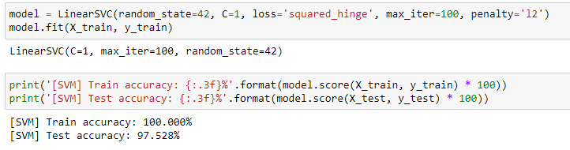
Improved Model with best parameters
After building a new Linear SVM model with the best parameters obtained from GridSearchCV, test accuracy slightly improves:
From 97.3% to 97.5%
Notes:
After building a new Linear SVM model with the best parameters obtained from GridSearchCV, test accuracy slightly improves:
From 97.3% to 97.5%

Slide 42
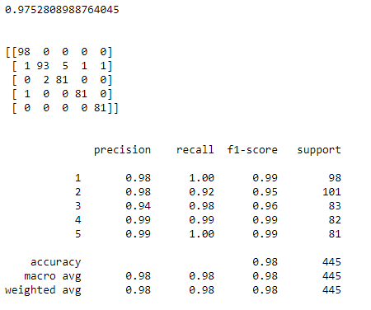
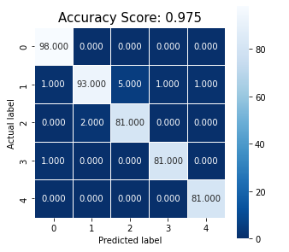
Confusion Matrix
Heat Map
Notes:
Here is the confusion matrix and the heat map for the SVM model. Interestingly, we can see that the model had some issues classifying labels 1 and 2, which were sports and business, where 5 business documents were incorrectly labelled as sports documents.

Slide 43
Summary and Further Improvements

Slide 44
Model Comparison and Evaluation
After building and tuning all our classification models, a summary table was made to compare and evaluate the performance of each model:
Classification model | Initial Test Accuracy | Fine Tuned Test Accuracy | Rank
Logistic Regression | 96.6% | 97.9% | 2
Random Forest | 96.5% | 97.1% | 4
Gradient Boosting | 96.6% | 99.1% | 1
Naïve Bayes | 89.9% | 91.3% | 5
Support Vector Machine | 97.3% | 97.5% | 3
From the table, we can see that:
The Gradient Boosting algorithm performed the best, at a test accuracy of 99.1%
This means that 99% of the time, this model was able to successfully classify the document into its corresponding category

Slide 45
Summary
By implementing different types of supervised machine learning models, along with improvement measures like GridSearchCV to tune hyperparameters, our group was able to see how each model performed
In addition, by using accuracy metrics and by weighing the pros and cons of each model, our group was able to determine the best classification model for this problem

Slide 46
Further Improvements
Lastly, further improvements in the aspect of performance assessment can also be considered
For example, despite being a multi-class classification problem, AUC/ROC curves can still be used as a suitable model evaluation metric
In such cases, for multi-class ROC analysis, some implementations could include one vs all class comparisons, or narrowing the scope to one vs one class comparisons
Deep learning models such as Recurrent Neural Networks that have been able to successfully process natural language text could also be experimented with to see better results can be obtained
Also, we could also have also tested a wider range of hyperparameter values which might have given us an even better model

